Slide 1
Governments of Latin America Activator
WARM UP
Compare the two types of government below according to how power is distributed and citizen participation.
Federal
Republic
Dictatorship

Slide 2
Learning Target: I can explain the differences between a federal-republican system and a dictatorship?
Standard:
SS6CG2a. Compare the federal-republican systems of the Federative Republic of Brazil (Brazil) and the United Mexican States (Mexico) to the dictatorship of the Republic of Cuba (Cuba).

Slide 3
Governments of Latin America
Before we begin our studies of specific governments of Latin America, let’s review some important concepts.
Take notes or highlight important concepts.

Slide 4
Forms of Leadership
Chief of State:
Leader of a country who represents the state at official and ceremonial functions, but who may not be involved with the day-to-day activities of the government.
Head of Government:
A country’s top administrative leader who is designated to manage the day-to-day activities of the government.

Slide 5
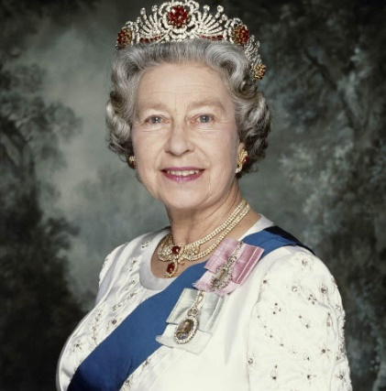
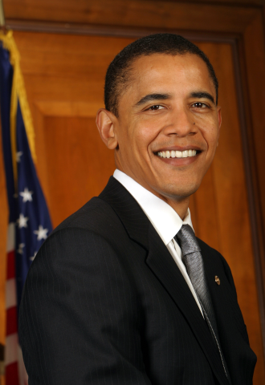
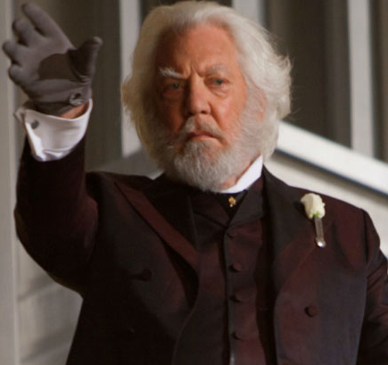
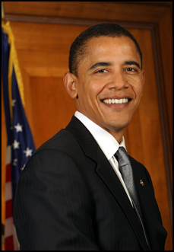
Form of Leadership
Chief of State
Head of Government
Notes:
If you or your students are not familiar with The Hunger Games, just skip to pictures of the actors or ask a student who does know how these relate.

Slide 6
Governments of Latin America
What is the Legislature?
The Law making body of government. For the U.S., it is Congress [House of Representatives and the Senate].

Slide 7
Create a chart or Print graphic organizer to take notes

Slide 8
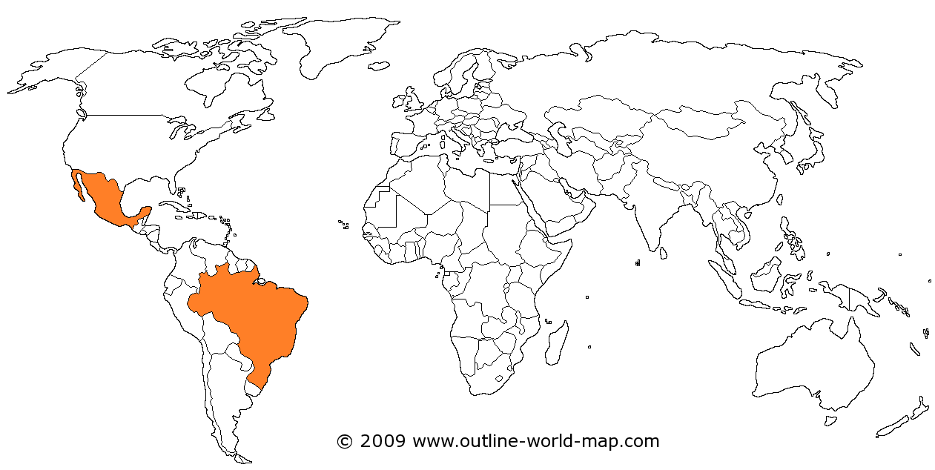
Governments of Latin America
Brazil and Mexico both have a Federal Republic.

Slide 9
Governments of Latin America
A Federal Republic is a state in which the powers of the central government are restricted and the parts (states, colonies, provinces) keep a degree of self-government.
Ultimate sovereign (supreme) power rests with the people who chose their representatives in government.

Slide 10
Federative Republic of Brazil (Brazil)

Slide 11
Form of Leadership in Brazil
Brazil has a President who is both the chief of state and head of government
The President is elected by
popular vote
The Bicameral National Congress (legislature with two houses) members are also elected.

Slide 12
Role of Citizens in Brazil
Citizens vote to elect both the President and the members of the Legislature
Voting is mandatory between the ages of 18-70 (voluntary between the ages of 16-18 and over 70).

Slide 13
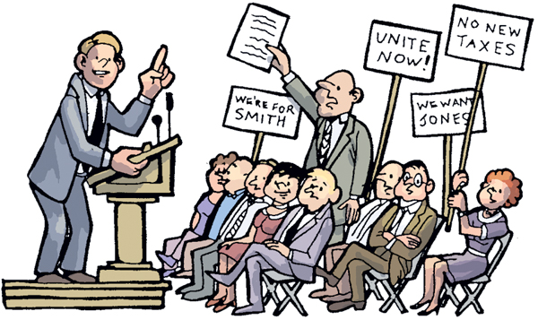

Personal Freedoms in Brazil
People can work where they want or
start a business [free trade and free enterprise].
Citizens enjoy personal freedoms like freedom of speech and freedom of assembly.

Slide 14
United Mexican States (Mexico)

Slide 15
Form of Leadership in Mexico
Mexico has a President who is both the chief of state and head of government
The President is elected by
popular vote
The Bicameral National Congress (legislature with two houses) members are also elected.

Slide 16
Role of Citizens in Mexico
Citizens vote to elect both the President and the members of the Legislature
Voting is mandatory for citizens over the age of 18 (but it is not enforced)

Slide 17
Personal Freedoms in Mexico
People can work where they want or
start a business [free trade and free enterprise].
Citizens enjoy personal freedoms like freedom of speech and freedom of assembly.

Slide 18
WARM UP
How is living in Brazil and Mexico i similar to and different from living in the U.S. [in terms of government].

Slide 19
Republic of Cuba (Cuba)

Slide 20
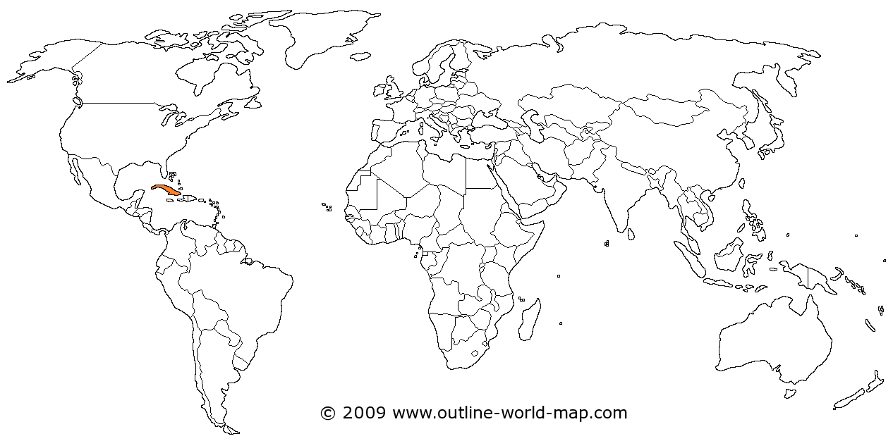
Governments of Latin America
Cuba is a dictatorship in which the ruler has absolute power (not restricted by a constitution of laws).

Slide 21
Form of Leadership in Cuba
Cuba has a President who is both the chief of state and head of government.
The President (dictator) is elected by the Unicameral National Assembly (legislature with one house). The last election was held in 2008.

Slide 22
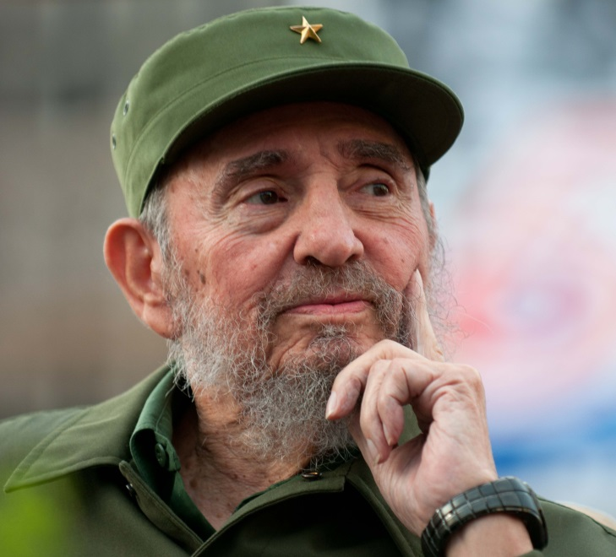
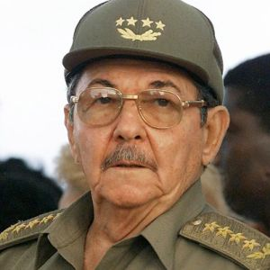
Form of Leadership in Cuba
Fidel Castro ruled Cuba from 1959 to 2008. When he stepped down his brother Raul became ruler.

Slide 23
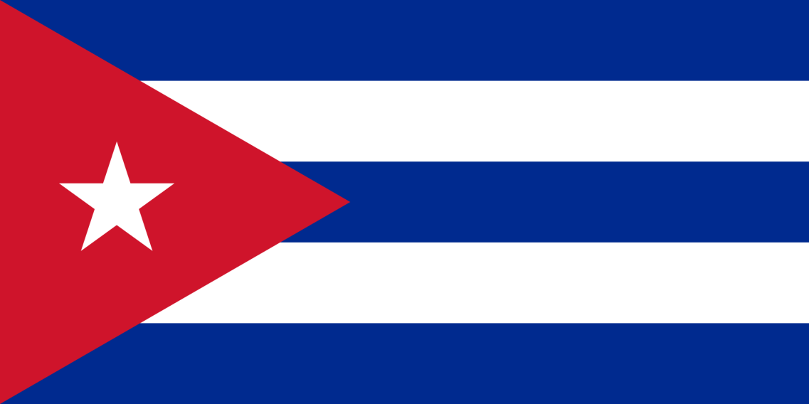
Form of Leadership in Cuba
Cuba’s official name is the Republic of Cuba. Why is
this misleading?

Slide 24
Form of Leadership in Cuba
The members of the Legislature are those officially sanctioned (approved) by Cuba’s Communist Party. They run for office unopposed.

Slide 25
Role of Citizens in Cuba
Citizens can “vote” at the age of 16 for members of the Legislature.
However, citizens can only vote for candidates selected by the Communist Party.

Slide 26
Personal Freedoms in Cuba
Cuba’s citizens do not have personal freedoms like freedom of speech.
They can be put in jail for criticizing the Communist Party or the president.
People cannot just work where they want to work or open their own business.

Slide 27
WARM UP
How does Cuba’s current government contradict the purpose of the Cuban Revolution.

Slide 28
Print or create your Government Chart to Complete the Comparison Graphic Organizer

Slide 29
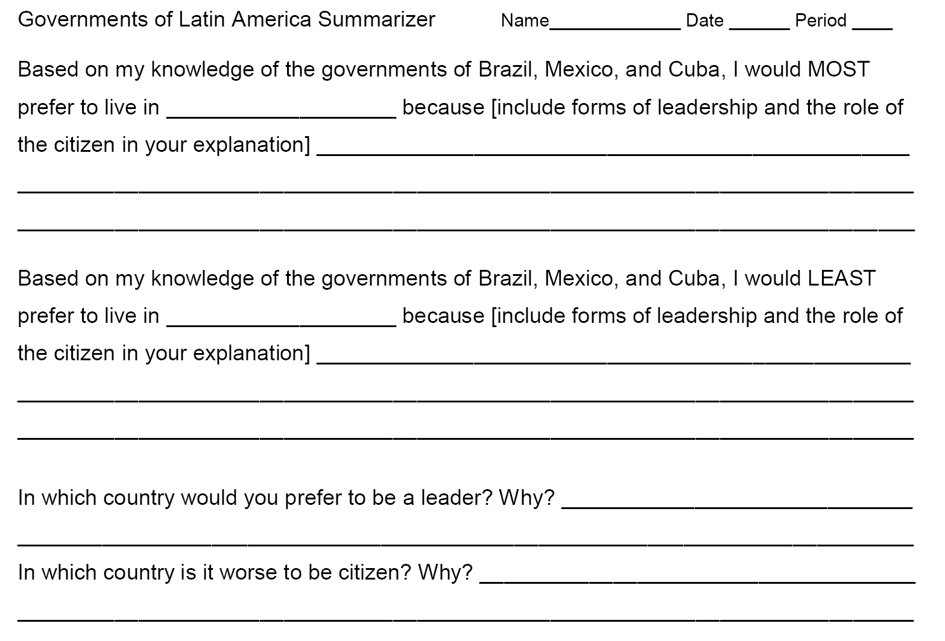
Latin American Government Summarizer

