Slide 1
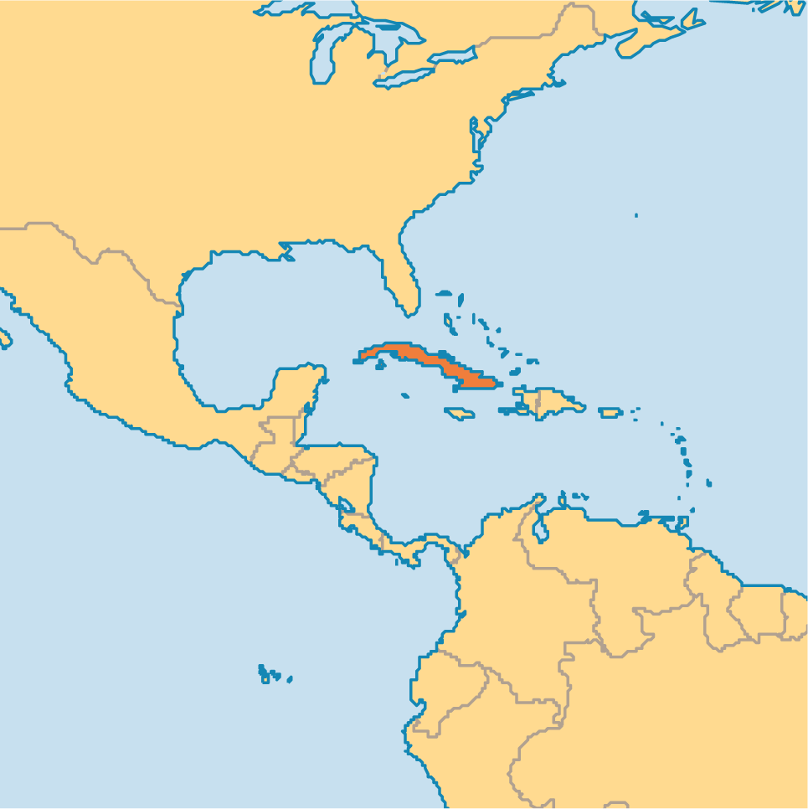
Write what you already know about Cuba. Include the government, economy, freedoms, etc.

Slide 2
In this lesson, we are going to examine a specific event that has had a lasting affect on the country of Cuba.

Slide 3
Essential Question: How did the Cuban Revolution impact Cuba?

Slide 4
Standard: SS6H3a. Explain the impact of the Cuban Revolution.

Slide 5
Let’s review what we have learned so far…

Slide 6
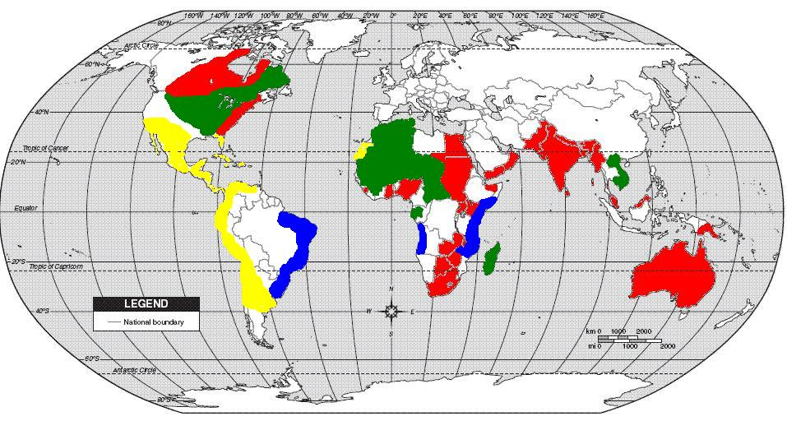
By the 15th century, European exploration and colonization was underway.

Slide 7
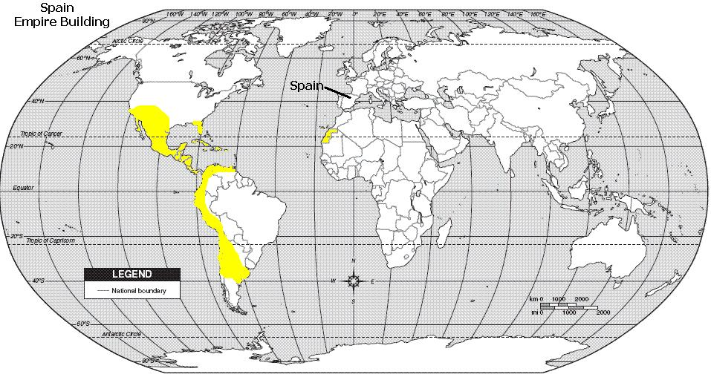
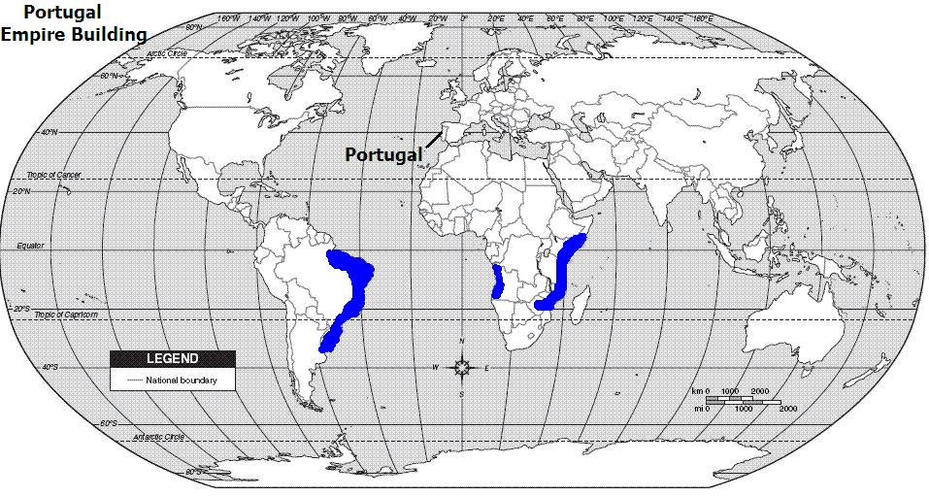
Spain and Portugal set up empires in Latin America.

Slide 8
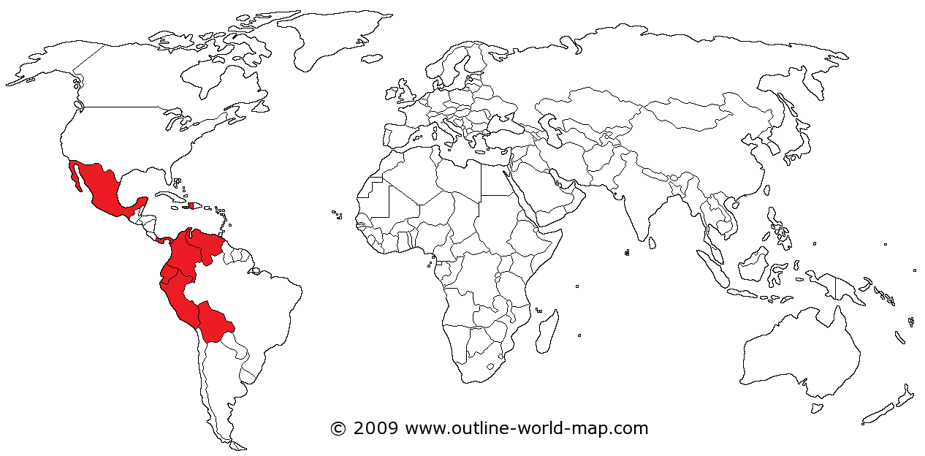
By the mid 19th century, most Latin American countries had achieved independence from Spain and Portugal.
Haiti:
Toussaint L’Ouverture
Mexico:
Miguel
Hidalgo
Venezuela, Colombia, Peru, etc:
Simón Bolívar
Brazil also gained independence from Portugal

Slide 9
This is where we begin…

Slide 10
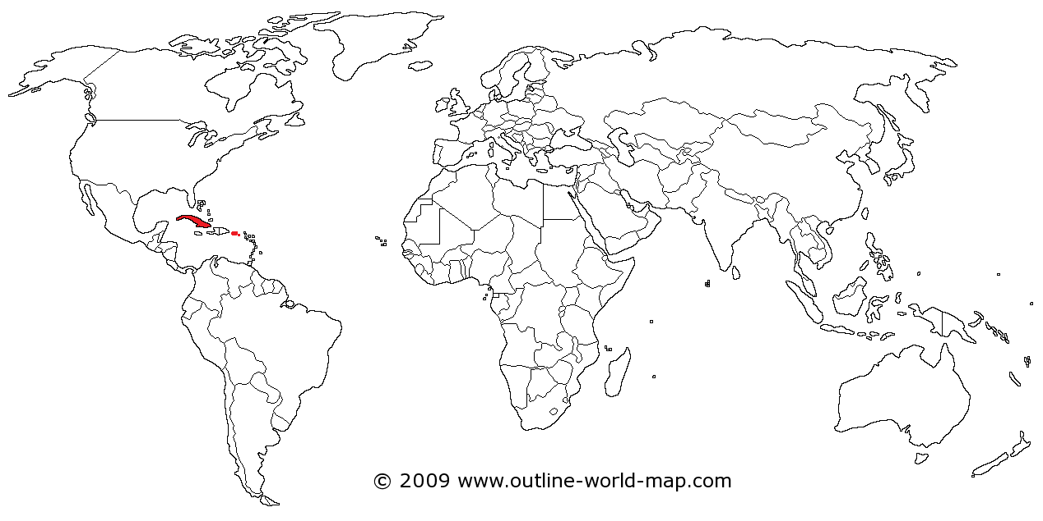
By the late 19th century, there were only two Spanish colonies left in the Americas.
Cuba
Puerto Rico

Slide 11
What can you remember about Cuba’s natural resources?
Cuba has rich soil which is good for growing sugarcane, coffee beans, tobacco, and other crops.
Sugar is Cuba’s most important product.

Slide 12
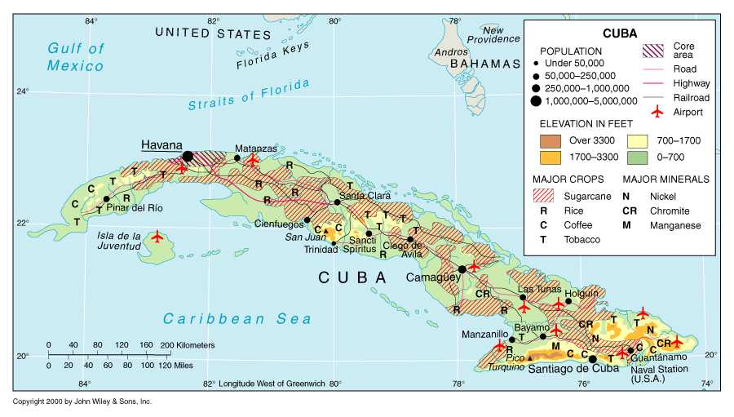
At the end of the 19th century, the U.S. declared war on Spain to help the people gain freedom from Spanish rule and to protect sugarcane plantations owned by American businesses.

Slide 13
The U.S. won the war, and Spain gave up Cuba and Puerto Rico.
Cuba
Puerto Rico

Slide 14
Puerto Rico became a U.S. territory. Cuba became independent, but stayed under U.S. control for many years.
Cuba
Puerto Rico

Slide 15
For the next 50 years, Cuba had many leaders (some elected, some dictators). The country was very wealthy, but most of the people were extremely poor.
Cuba

Slide 16
What’s a dictator?
A ruler with total power over a country, typically one who has obtained power by force

Slide 17
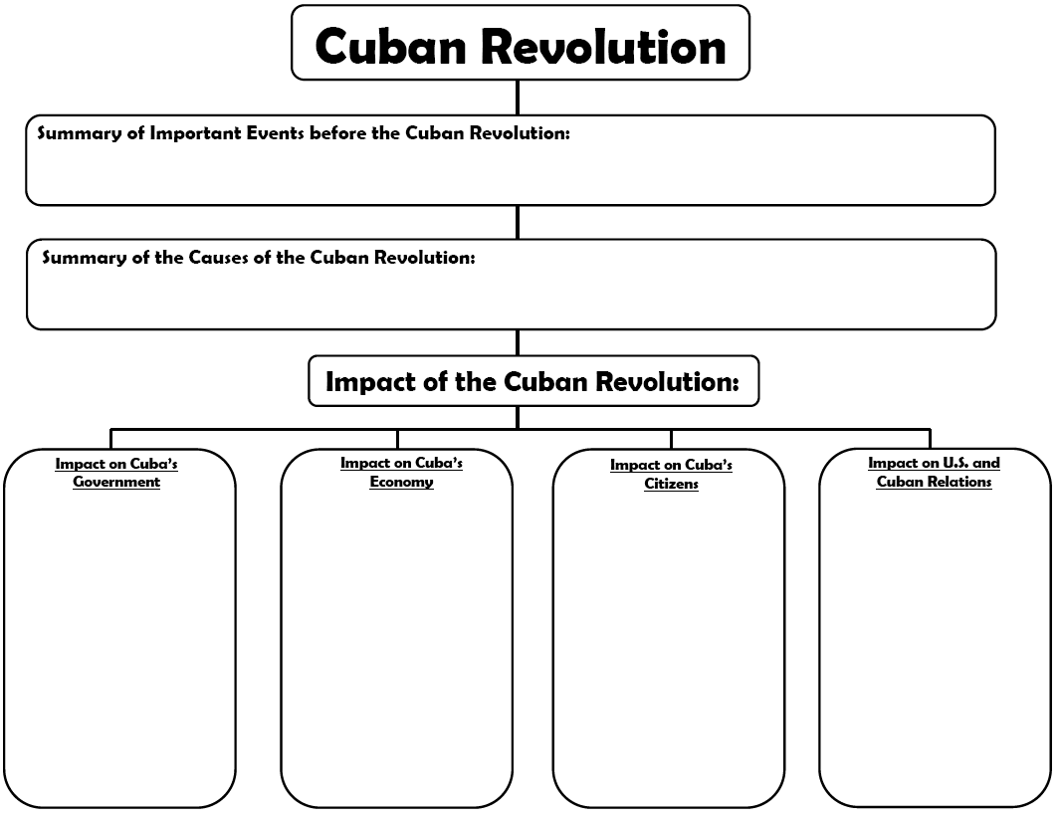
With a partner, summarize the important events before the Cuban Revolution on your graphic organizer.

Slide 18
Cuba gained independence when the U.S. fought
a war with Spain to gain Cuba’s freedom and protect U.S. sugarcane plantations. Cuba had many leaders over the
years following their independence. Some leaders were elected and some leaders were dictators.

Slide 19
Why do revolutions occur?

Slide 20
Which group was exploited (taken advantage of) in Cuba?
The poor were taken advantage of in Cuba and were angry with their government.

Slide 21
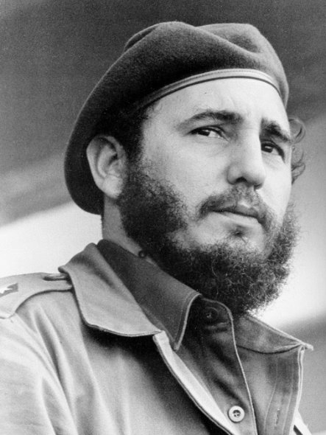
Just like in other Latin American countries, a leader emerged to take up the cause…
Fidel Castro

Slide 22
In the late 1950s, Fidel Castro led an army of rebels and defeated the corrupt government (a dictator named Batista).
This is known as the Cuban Revolution.
Notes:
This would be a good place to then do the Cuban Revolution Quotes on page 74 or 75 of the Georgia Experience workbook.

Slide 23
With a partner, summarize the causes of the Cuban Revolution on your graphic organizer.

Slide 24
Even though the country was very wealthy, most of the
people were extremely poor. Unhappy Cubans were continually angry with their government. In the late 1950s, Fidel
Castro led a group of rebels and defeated the corrupt government. He took over and set up a communist government.

Slide 25
Fidel Castro immediately set up a communist government.
What is communism?

Slide 26
Communism is a political and economic system in which the major productive resources in a society are owned by the public or the state, and wealth is divided among citizens equally or according to individual need.
Notes:
Definition from Britannica Kids

Slide 27
Where does communism fall on the economic continuum?
Toward Command Economy

Slide 28
How is power distributed in communism?
Unitary

Slide 29
World Revolution For Students – Castro and the Cuban Revolution Part I [15:03]

Slide 30
Use your graphic organizer to record the impact of the Cuban Revolution

Slide 31
Impact on Cuba’s Government
In reality, Cuba just went from one dictator to another
Castro set up a communist government like its ally (supporter), the Soviet Union, and controlled all aspects of the government

Slide 32
How do you think Cuba’s economy was affected by the Cuban Revolution?

Slide 33
Impact on Cuba’s Economy
Castro set up a communist government which controlled all parts of the economy
He took over farms and businesses, even those owned by the U.S.

Slide 34
Impact on Cuba’s Economy
The Soviet Union was a key ally and trading partner, but when they broke apart, Cuba’s economy suffered and still struggles today
Food shortages occur from time to time

Slide 35
How do you think Cuba’s citizens were affected by the Cuban Revolution?

Slide 36
Impact on Cuba’s Citizens
Many poor people supported Castro’s policies because he improved their healthcare and education
Successful Cubans such as business owners, teachers, doctors, and others did not like their property being taken.

Slide 37
Impact on Cuba’s Citizens
Due to Castro’s communist policies, many successful Cubans left (many went to Florida)
People who opposed Castrol were killed or put in prison
He controlled everything on the radio, TV, and newspapers.

Slide 38
How do you think the Cuban Revolution affected Cuba’s relationship with the U.S.?

Slide 39
Impact on U.S. and Cuban Relations
Castro came to power during the Cold War and sided with the Soviet Union causing hostilities
Castro took over American businesses without giving compensation (costs) to owners
The U.S. imposed an embargo on exports except for food and medicine to Cuba in 1960 and cut off all ties with Cuba in 1961

Slide 40
With an elbow partner, discuss the following: Was the Cuban Revolution good or bad for Cuba? Why?

Slide 41
In 2008, Raúl Castro, Fidel Castro’s brother, replaced Fidel when he became too ill to lead the country. Cuba’s government structure remains the same, but Raúl has opened the economy in some ways.

Slide 42
Inside Cuba 1 of 2 BBC Our World Documentary [10:28]
Inside Cuba 2 of 2 BBC Our World Documentary [10:57]

Slide 43
Which group benefited the most from the Cuban Revolution? Why?
The poor because they gained education, healthcare, and more equal treatment

Slide 44
Which group benefited the least from the Cuban Revolution? Why?
The wealthy, land owners, and business owners because Castro took their property for the state

Slide 45
WARM UP 3/10/2020
Latin American is ethnically diverse because of a blending of what ethnic groups?
Which term best describes the type of government in Cuba since 1959?
Constitutional Monarchy
Patriotic Oligarchy
C. Autocratic Dictatorship
D. Parliamentary Democracy

Slide 46
Summarizer – Identify a few impacts of the Cuban Revolution

