Slide 1
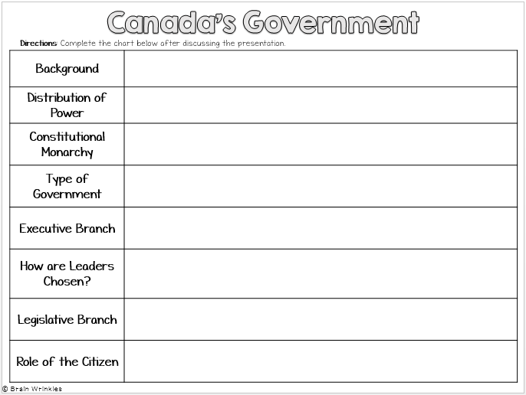
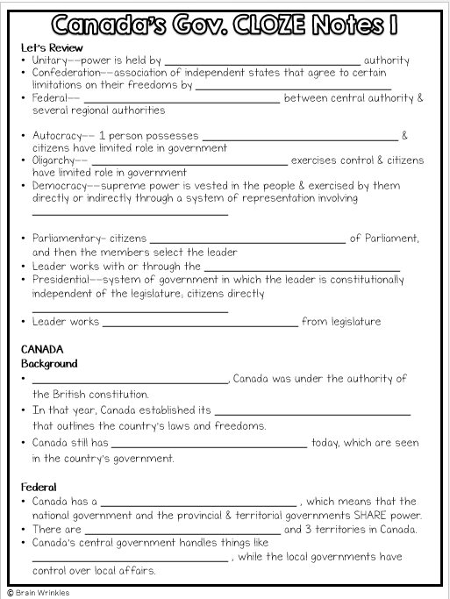
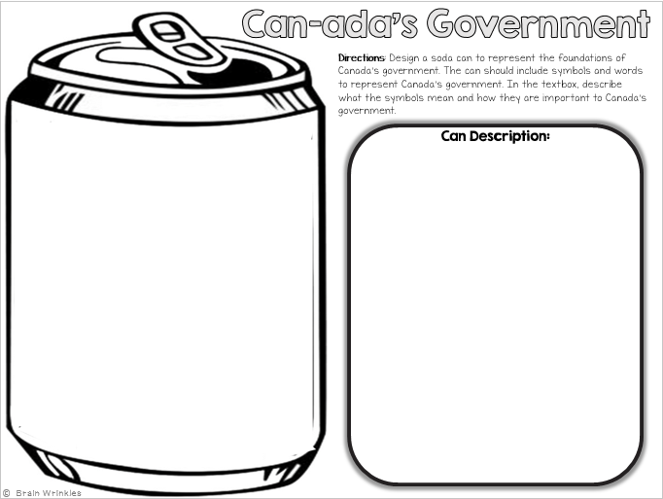
Canada’s
GOVERNMENT
GOVERNMENT
Presentation, Graphic Organizers, & Activities

Slide 2
LEARNING TARGET
I can explain the role that citizens play in choosing the leader of Canada (parliamentary Democracy).
© Brain Wrinkles

Slide 3
STANDARDS:
SS6CG2 Explain citizen participation in the Canadian government.
a. Explain the role of citizens in choosing the leader of Canada (parliamentary democracy).
© Brain Wrinkles

Slide 4
Notes:
The next pages are handouts for note-taking (Print front to back to save paper and ink.)
OR
Copy to Microsoft Word and take notes in this way.
© Brain Wrinkles

Slide 5
Let’s Review
Autocracy-- 1 person possesses _______________________ & citizens have limited role in government
Democracy--supreme power is vested in the people & exercised by them directly or indirectly through a system of representation involving _______________________
Parliamentary– citizens _______________________ of Parliament, and then the members select the leader
Leader works with or through the _______________________
Presidential--system of government in which the leader is constitutionally independent of the legislature; citizens directly _______________________
Leader works _______________________ from legislature
CANADA
Background
_______________________, Canada was under the authority of the British constitution.
In that year, Canada established its _______________________ that outlines the country’s laws and freedoms.
Canada still has ties to the United Kingdom today, which can be seen in the country’s _______________________ that is structured like Great Britain’s.
Constitutional Monarchy
Canada can be described as a _______________________ , which means that it has its own constitution but its head of state is the monarch of Great Britain.
Since the monarch does not live in Canada, she chooses a governor-general to _______________________ .
Both of these roles are mostly ceremonial and hold _______________________ .
© Brain Wrinkles
Canada’s Gov. CLOZE Notes 1

Slide 6
Leadership
Head of State: Monarch of the United Kingdom (presently, Queen Elizabeth II); _______________________ with little political power
Governor General: stands in _______________________ to represent her interests in Canada
Prime Minister: holds the _______________________ and makes key executive decisions; works closely with the legislature
How Leaders Are Chosen
Monarch: position _______________________ through family line
Governor General: _______________________ ; serves a 5-year term
Prime Minister: citizens age 18 and older vote to elect members to the House of Commons. The governor general then selects a prime minister from the _______________________ in the elected legislature.
Legislature
A country’s legislature is its central authority (_______________________ ).
Canada’s legislature is called _______________________ .
The citizens of Canada _______________________ of one house of Parliament.
Members of Parliament belong to many _______________________ .
The Parliament of Canada is the country’s _______________________ legislature.
It consists of:
1. Senate (105 seats): members are _______________________ with advice from the Prime Minister.
Members are _______________________ by the people; can serve until they are 75 years old
2. House of Commons (308 seats): members are _______________________ by the people
Members serve _______________________
_______________________ is chosen from the majority party in the House of Commons.
© Brain Wrinkles
Canada’s Gov. CLOZE Notes 2

Slide 7
Parliamentary Democracy
The prime minister is selected from the _______________________ in the legislature.
This is the _______________________ between a Presidential Democracy and a Parliamentary Democracy
Parliamentary Democracy – legislature (Parliament) _______________________ (Executive Leader)
Citizens _______________________ of the House of Commons, not directly for the prime minister.
In Canada, the prime minister and his cabinet are members of the legislature, and they must _______________________ .
The government will stay in office for a specified period unless the prime minister _______________________ in the legislature on an important vote.
If that happens, the prime minister _______________________ and a new one is chosen immediately.
Role of the Citizen
Citizens must be _______________________ , but voting is not required by law.
As a democracy, Canada’s citizens can _______________________ and elections.
The citizens _______________________ of the Parliament, not directly for the prime minister.
Canada’s constitution guarantees citizens _______________________ and freedoms, much like what we have in the United States.
Some examples include equal rights, _______________________ , freedom of religion, and right to a fair trial.
The right to communicate with the national government in either _______________________ is also included.
© Brain Wrinkles
Canada’s Gov. CLOZE Notes 3

Slide 8
Canada’s
Government
Constitutional Monarchy
Parliamentary Democracy
© Brain Wrinkles

Slide 9
Let’s Review
Government TYPES– HOW DO CITIZENS PARTICIPATE?
Autocracy-- 1 person possesses unlimited power & citizens have limited role in government
Democracy--supreme power is vested in the people & exercised by them directly or indirectly through a system of representation involving free elections
© Brain Wrinkles

Slide 10
Let’s Review
TWO TYPES OF DEMOCRATIC GOVERNMENTS:
Parliamentary– citizens elect members of Parliament, and then the members select the leader
Leader works with or through the legislature
Presidential--system of government in which the leader is constitutionally independent of the legislature; citizens directly elect leader
Leader works separate from legislature
© Brain Wrinkles

Slide 11
CANADA
© Brain Wrinkles

Slide 12
Background
Until 1982, Canada was under the authority of the British constitution.
In that year, Canada established its own constitution that outlines the country’s laws and freedoms.
Canada still has ties to the United Kingdom today, which can be seen in the country’s parliamentary democracy that is structured like Great Britain’s.
© Brain Wrinkles

Slide 13
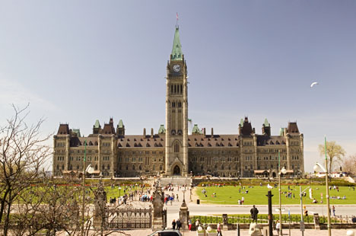
Parliament Hill, in Ottawa, Ontario, is home to Canada’s central government.
© Brain Wrinkles

Slide 14
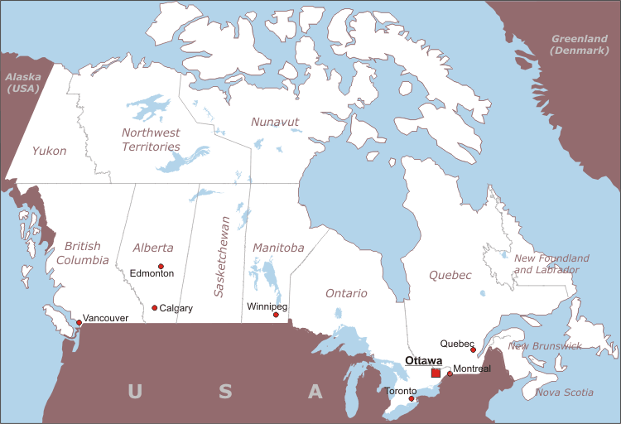
© Brain Wrinkles

Slide 15
It has
Constitutional
Monarchy
Canada can be described as a constitutional monarchy, which means that it has its own constitution but its head of state is the monarch of Great Britain.
Since the monarch does not live in Canada, she chooses a governor-general to act in her place.
Both of these roles are mostly ceremonial and hold very little power.
© Brain Wrinkles

Slide 16
Leadership
1. Head of State: Monarch of the United Kingdom (presently, Queen Elizabeth II); mostly ceremonial with little political power
2. Governor General: stands in for the monarch to represent her interests in Canada
3. Prime Minister: holds the most political power and makes key executive decisions; works closely with the legislature
© Brain Wrinkles

Slide 17
Her Majesty
Queen Elizabeth II
© Brain Wrinkles

Slide 18
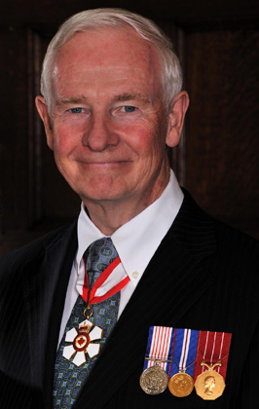
His Excellency
The Right Honorable
David Johnston
Governor General
© Brain Wrinkles

Slide 19
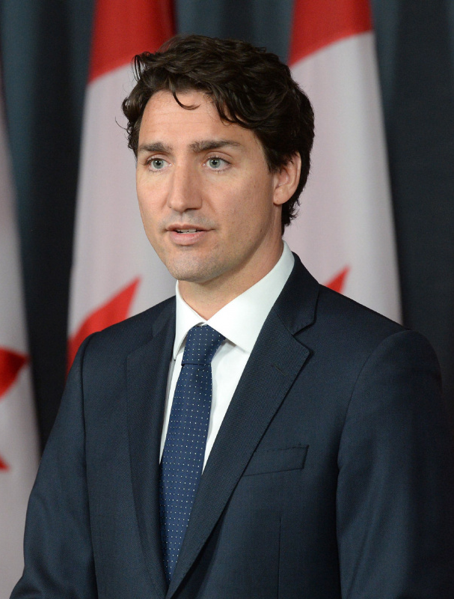
The Right Honorable
Justin Trudeau
Prime Minister
© Brain Wrinkles

Slide 20
How Leaders
Are Chosen
Monarch: position inherited through family line
Governor General: appointed by the monarch; serves a 5-year term
© Brain Wrinkles

Slide 21
How Leaders
Are Chosen
Prime Minister: Citizens age 18 and older vote to elect members to the House of Commons. The governor general then selects a prime minister from the majority party in the elected legislature.
© Brain Wrinkles

Slide 22
Legislature
A country’s legislature is its central authority (law-making body).
Canada’s legislature is called Parliament.
The citizens of Canada vote for members of one House of Parliament.
Members of Parliament belong to many different political parties.
© Brain Wrinkles

Slide 23
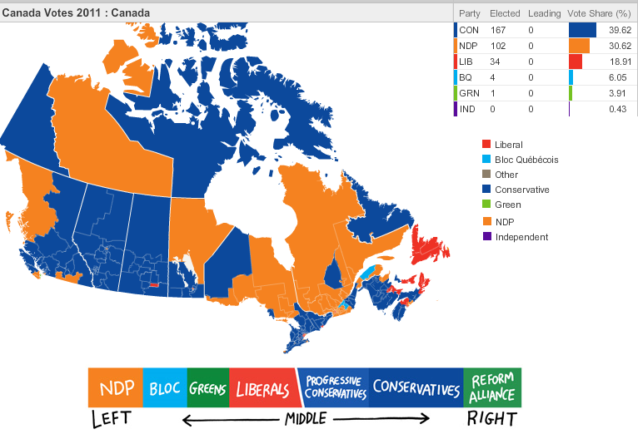
Political Parties in Canada’s Government
© Brain Wrinkles

Slide 24
Legislature
The Parliament of Canada is the country’s bicameral legislature.
It consists of:
Senate (105 seats): members are appointed by the governor general with advice from the Prime Minister
Members are not elected by the people; can serve until they are 75 years old
2. House of Commons (308 seats): members are directly elected by the people
Members serve 5-year terms
Prime Minister is chosen from the majority party in the House of Commons.
© Brain Wrinkles

Slide 25
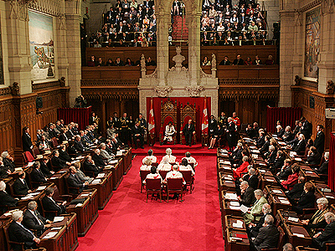
Canadian Senate
© Brain Wrinkles

Slide 26
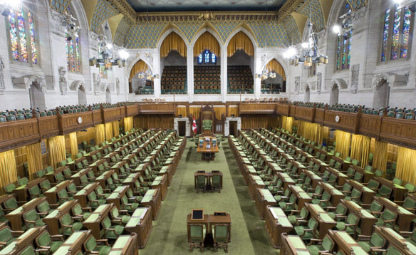
Canadian House of Commons
© Brain Wrinkles

Slide 27
Parliamentary
Democracy
The prime minister is selected from the majority party in the legislature.
This is the major difference between a Presidential Democracy and a Parliamentary Democracy!
Parliamentary Democracy – legislature (Parliament) chooses Head of Government (Executive Leader)
Citizens vote for members of the House of Commons, not directly for the prime minister.
© Brain Wrinkles

Slide 28
Parliamentary
Democracy
In Canada, the prime minister and his cabinet are members of the legislature, and they must answer to the legislature.
The government will stay in office for a specified period unless the prime minister loses support of the majority in the legislature on an important vote.
If that happens, the prime minister must resign and a new one is chosen immediately.
© Brain Wrinkles

Slide 29
Role of the
Citizen
Citizens must be 18 to vote, but voting is not required by law.
As a democracy, Canada’s citizens can participate in voting and elections.
The citizens vote for members of the Parliament, not directly for the prime minister.
© Brain Wrinkles

Slide 30
Role of the
Citizen
Canada’s constitution guarantees citizens many personal rights and freedoms, much like what we have in the United States.
Some examples include equal rights, freedom of speech, freedom of religion, and right to a fair trial.
The right to communicate with the national government in either French or English is also included.
© Brain Wrinkles

Slide 31
TEACHER INFO: Government Chart
Print off the Government chart is you have access to a printer, or Copy to Microsoft word, or create on paper.
Complete the chart without looking back at the presentation to see how much you remember.
Check the answers when you have completed the form and send it to me by email.
© Brain Wrinkles

Slide 32
Canada’s Government
Directions: Complete the chart below after discussing the presentation.
Background
Constitutional Monarchy
Type of Government
Executive Branch
How are Leaders Chosen?
Legislative Branch
Role of the Citizen
© Brain Wrinkles

Slide 33
Cookin’ Up Canada’s Government (Recipe)
Print off the Cookin’ Up Canada’s Government handout, or Copy to Microsoft word, or create on paper version
Write a “recipe” for Canada’s government (include several ingredients that were used to form the government).
Next, write out the special cooking instructions for bringing the ingredients together.
© Brain Wrinkles

Slide 34
Directions: Write a “recipe” for Canada’s government. Include several ingredients that were used to form the government. Also, write out the special cooking instructions for bringing the ingredients together.
Ingredients:
-
-
-
-
-
-
Instructions:
________________________________________________________________________________________________________________________________________________________________________________________________________________________________________________________________________________________
________________________________________________________________________________________________________________________________________________________________________________________________________________________________________________________________________________________
© Brain Wrinkles
Cookin’ Up Canada’s
Government

Slide 35
TEACHER INFO: Commemorative Can
Print off the Create A Can handout, or Copy to Microsoft word, or create on paper version.
Design a soda can to represent the foundations of Canada’s government. The can should include symbols & words to represent Canada’s government.
In the textbox, the students will describe what the different symbols on the can represent and how they are important to Canada’s government.
© Brain Wrinkles

Slide 36
Can-ada’s Government
Directions: Design a soda can to represent the foundations of Canada’s government. The can should include symbols and words to represent Canada’s government. In the textbox, describe what the symbols mean and how they are important to Canada’s government.
Can Description:
© Brain Wrinkles

Slide 37
TEACHER INFO: True/False Review
Print off the cards on the following page (or have students quickly make their own on scrap paper).
Project the True/False statements and have the students hold up the correct end of the card.
After you scan to see the students’ answers, display the Answer slide.
© Brain Wrinkles

Slide 38
TRUE
FALSE
© Brain Wrinkles
TRUE
FALSE
© Brain Wrinkles

Slide 39
True or False?
In a democracy, citizens play an important role because they are able to vote for leaders.
© Brain Wrinkles

Slide 40
True or False?
Canada has a presidential democracy.
© Brain Wrinkles

Slide 41
True or False?
Although Canadians adopted their own constitution in 1982, they still have ties with the British government.
© Brain Wrinkles

Slide 42
True or False?
Citizens do not directly vote for the prime minister in Canada.
© Brain Wrinkles

Slide 43
True or False?
The Parliament makes new laws for Canada.
© Brain Wrinkles

Slide 44
True or False?
In a democracy, a ruler has absolute power and the citizens do not possess the right to choose their own leaders.
© Brain Wrinkles

Slide 45
True or False?
The British monarch is the most influential person in Canada’s government.
© Brain Wrinkles

Slide 46
True or False?
Canadian citizens have many personal freedoms guaranteed to them in their constitution.
© Brain Wrinkles

Slide 47
True or False?
The governor general comes to the role by hereditary line.
© Brain Wrinkles

Slide 48
True or False?
In a presidential democracy, citizens vote for members of the legislature and the members select the country’s leader.
© Brain Wrinkles

Slide 49
True or False?
The governor general selects a prime minister from the majority party in Parliament.
© Brain Wrinkles

Slide 50
True or False?
Canadian citizens vote for representatives to the Senate.
© Brain Wrinkles

Slide 51
True or False?
In Canada, voting starts at age 18 and is not required by law.
© Brain Wrinkles

Slide 52
True or False?
The head of Canada’s government (person with the most political power) is the governor-general.
© Brain Wrinkles

Slide 53
TICKET OUT THE VIRTUAL DOOR
Give Canada a grade based on its government.
In the comments section, explain why you chose the grade/effort and what things the country can do to improve.
© Brain Wrinkles

Slide 54
Name:
Name:
Report Card
Report Card
You are the teacher! Give Canada a grade based on its government. In the comments section, explain why you chose the grade/effort and what things the country can do to improve.
You are the teacher! Give Canada a grade based on its government. In the comments section, explain why you chose the grade/effort and what things the country can do to improve.
Name: Canada
Name: Canada
Grade:
Effort:
Comments
Grade:
Effort:
Comments
© Brain Wrinkles
© Brain Wrinkles

