Slide 1
STANDARDS:
SS6G2 The student will discuss environmental issues in Latin America.
a. Explain the major environmental concerns of Latin America regarding the issues of air pollution in Mexico City, Mexico, the destruction of the rain forest in Brazil, and oil-related pollution in Venezuela.
This Photo by Unknown Author is licensed under CC BY-SA
© Brain Wrinkles

Slide 2
Latin America’s
Environmental
Issues
Air pollution in Mexico City, the destruction of the rain forest in Brazil, & oil-related pollution in Venezuela
© Brain Wrinkles

Slide 3
Air Pollution
in
Mexico City
© Brain Wrinkles

Slide 4
Mexico City
Nearly 20 million people live in Mexico City.
It’s the second most populated city in the world--Tokyo is first.
The city’s population & location contribute to its bad air pollution problem.
It’s considered to be one of the most polluted cities in the world!
© Brain Wrinkles

Slide 5
© Brain Wrinkles

Slide 6
© Brain Wrinkles

Slide 7
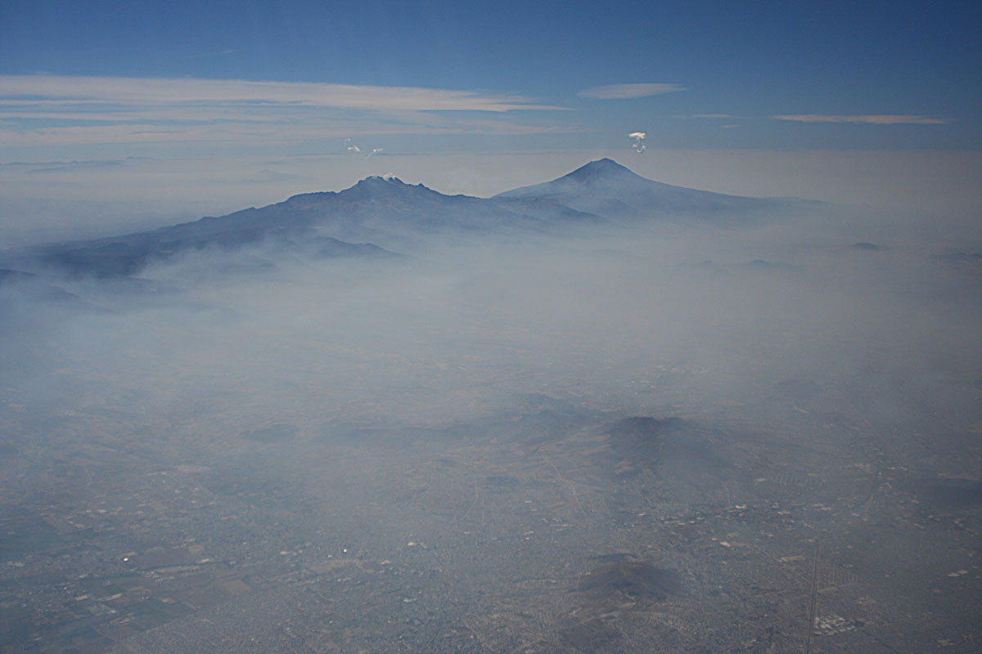
© Brain Wrinkles

Slide 8
Causes
Mexico City’s air pollution is caused by emissions from cars and factories.
The Sierra Madre mountains are like walls that surround the city and trap in polluted air.
© Brain Wrinkles

Slide 9
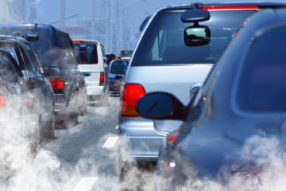
© Brain Wrinkles

Slide 10
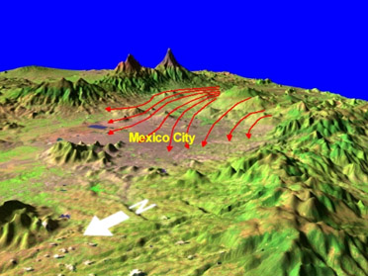
© Brain Wrinkles

Slide 11
Results
Mexico City has a high elevation. There is less oxygen so fuels don’t fully burn.
This makes a higher level of gas, which can harm eyes, lungs, & the heart.
People living in the city breathe in toxic gases and chemicals, which can lead to respiratory diseases.
© Brain Wrinkles

Slide 12
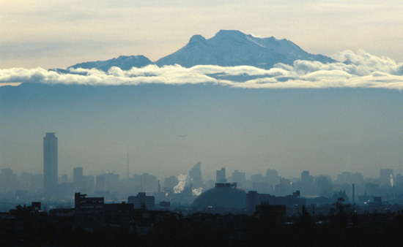
© Brain Wrinkles

Slide 13
Solutions
To reduce air pollution, the city promotes public transportation (buses, subway, bikes, etc.).
The city is also testing buses that run on cleaner burning fuels.
The Mexican government is starting to limit how often you can drive your car and has adopted stricter emission inspections.
© Brain Wrinkles

Slide 14
This Photo by Unknown Author is licensed under CC BY-SA

Slide 15
Destruction
of the
Amazon
Rain Forest
© Brain Wrinkles

Slide 16
Amazon Rain Forest
It’s the largest rain forest left in the world.
Most of the rain forest is in Brazil.
It experiences a hot, humid, & rainy tropical climate.
It’s home to a huge variety of plants, trees, insects, birds, & animals.
It produces 1/3 of the earth’s oxygen!
© Brain Wrinkles

Slide 17
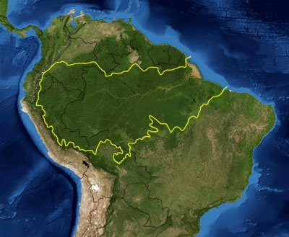
© Brain Wrinkles

Slide 18
Deforestation
In the 1950s, the Brazilian government began building a major highway system.
This opened the rain forest to loggers.
Huge parts of the rain forest are being cut down to plant crops using the “slash and burn” farming method.
Cattle ranching and mining have also become prevalent in this area.
© Brain Wrinkles

Slide 19
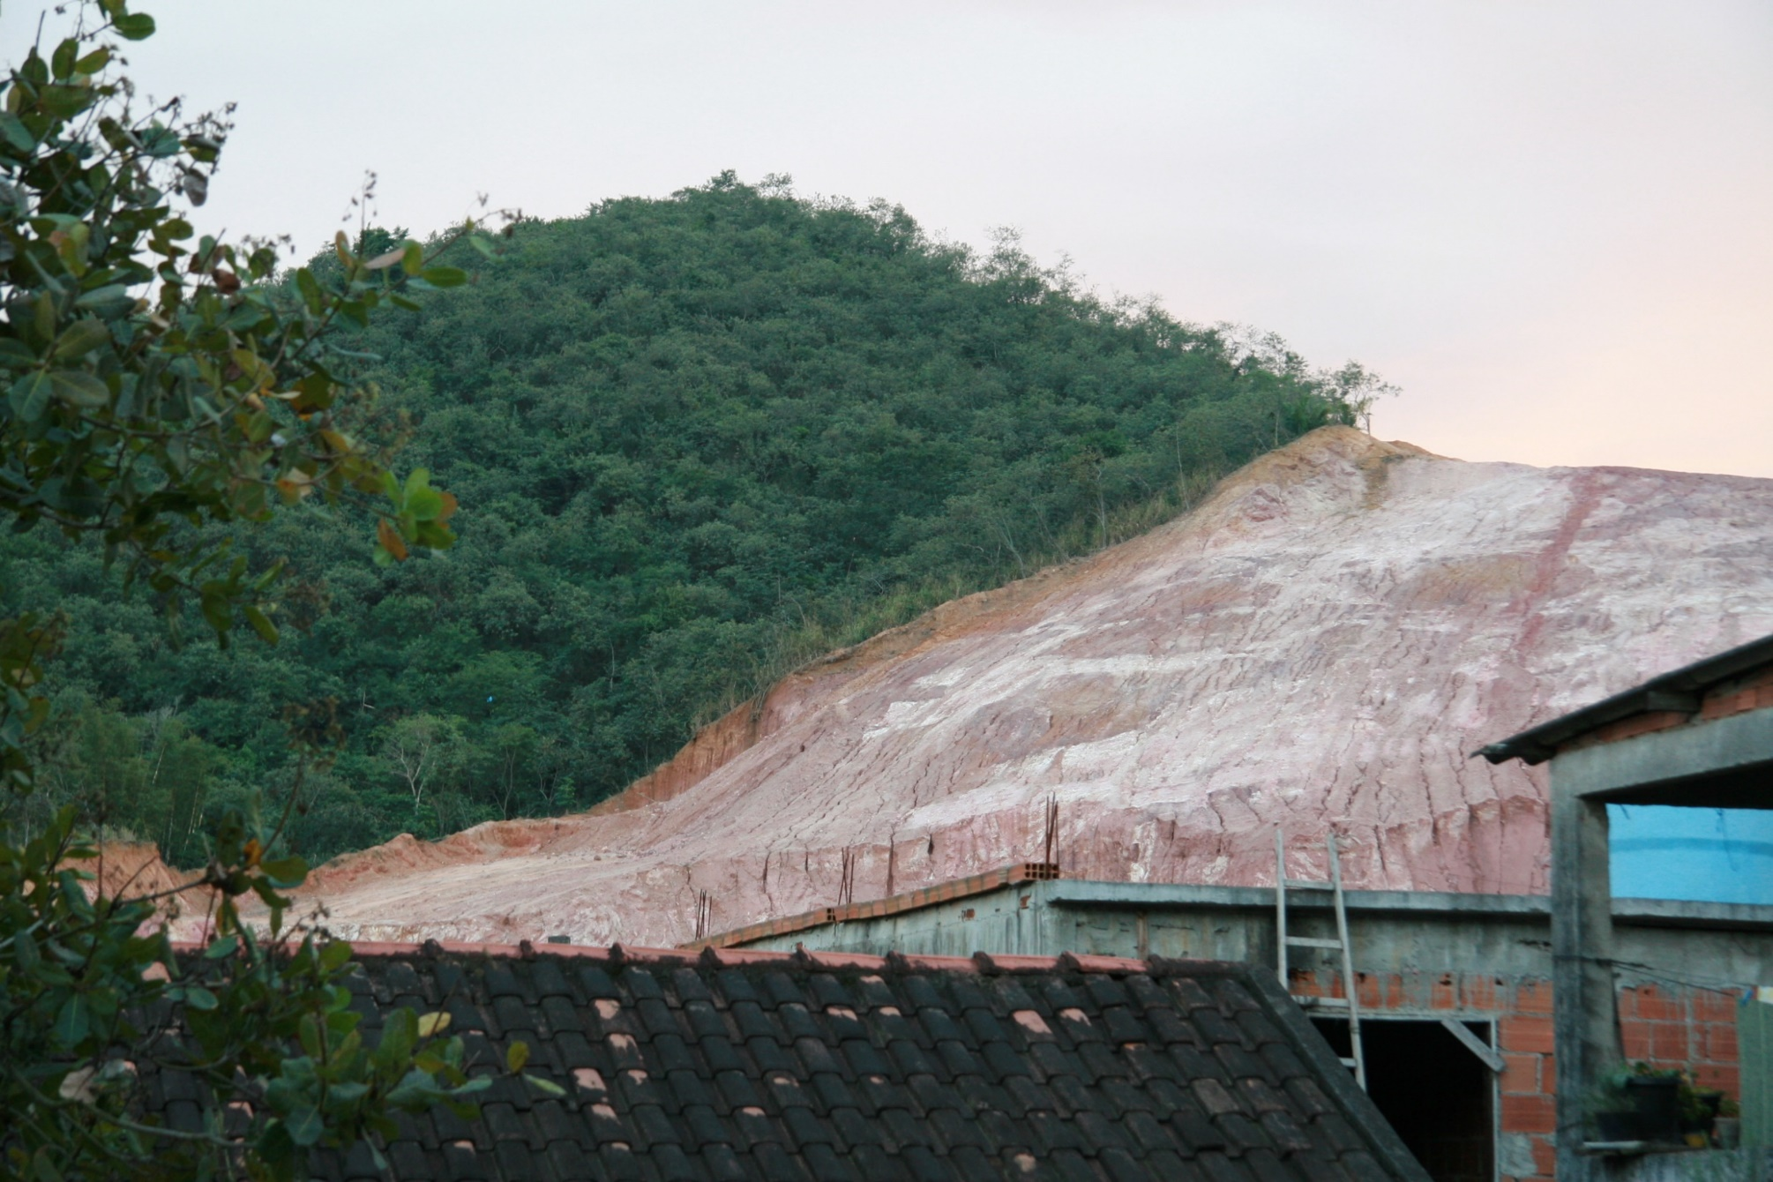
© Brain Wrinkles

Slide 20
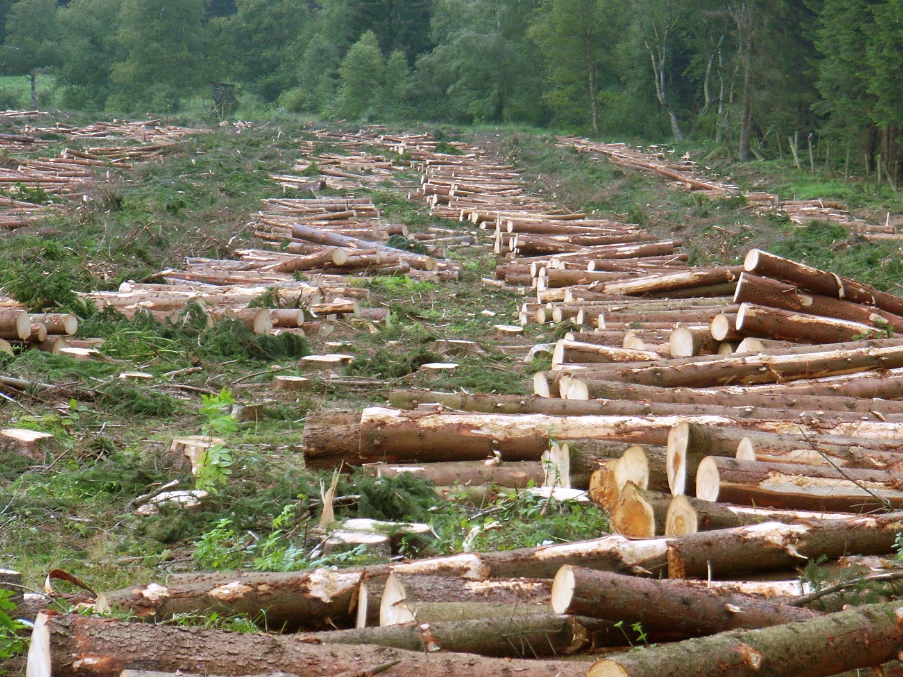
© Brain Wrinkles

Slide 21
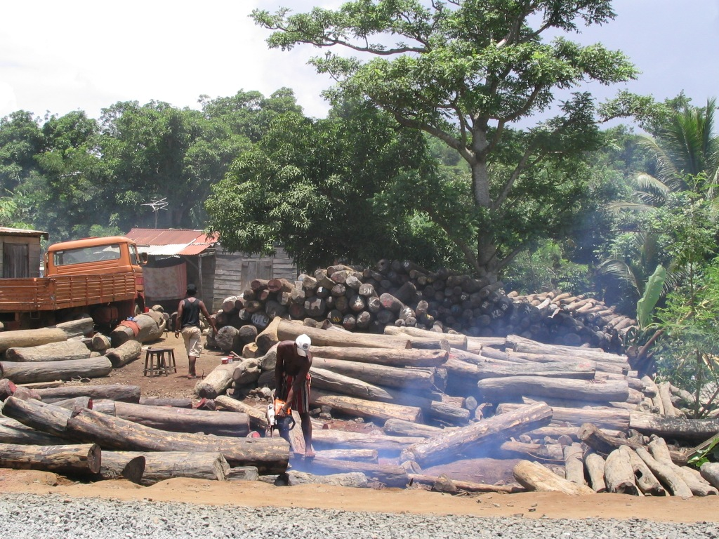
© Brain Wrinkles

Slide 22
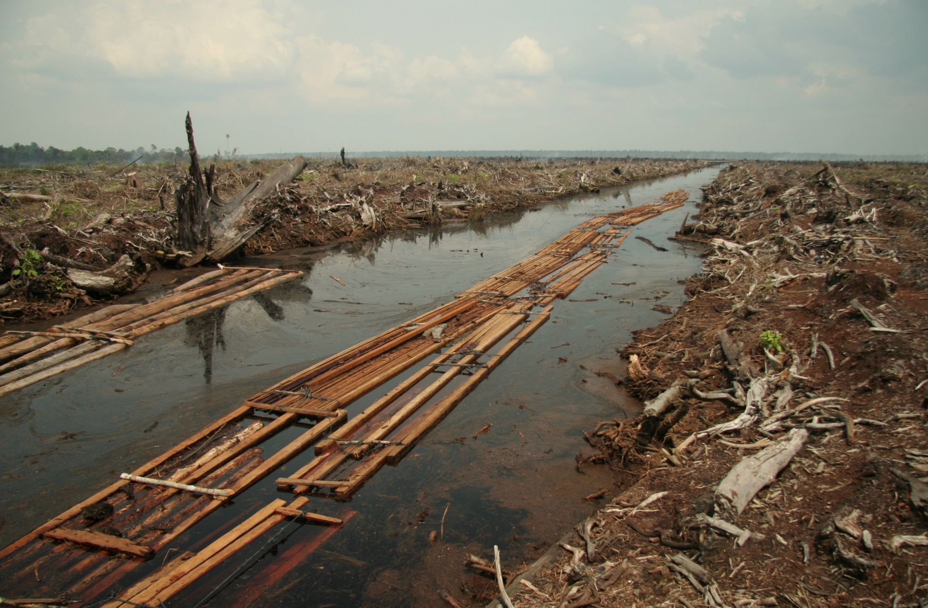
© Brain Wrinkles

Slide 23
Results
Millions of plants & animals are losing their homes.
Many are endangered, and some are becoming extinct.
The loss of trees increases carbon dioxide, a gas that contributes to global warming.
© Brain Wrinkles

Slide 24
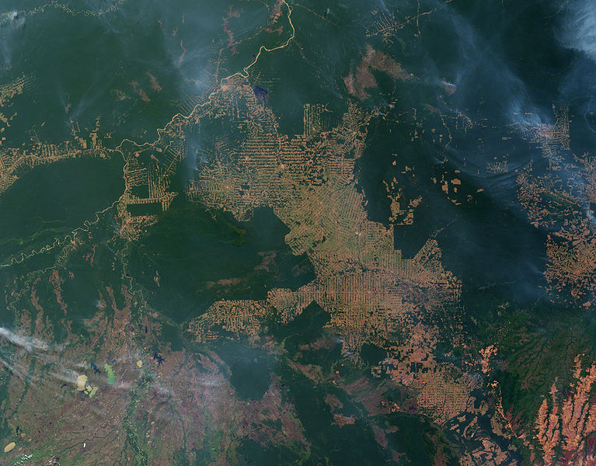
© Brain Wrinkles

Slide 25
© Brain Wrinkles

Slide 26
Solutions
The government is working to fix the deforestation problem by setting aside large protected areas.
Brazil’s government has also set up programs to plant new trees where old ones have been cut down.
© Brain Wrinkles

Slide 27
Oil Pollution
In
Venezuela
© Brain Wrinkles

Slide 28
Venezuela
It’s one of the world’s leading producers of oil.
It has been producing oil for about 100 years.
Oil production has boosted the economy and provides about 50% of its revenue.
It’s the main source of income for many people.
Oil production results in toxic wastes, air pollution, & oil spills.
© Brain Wrinkles

Slide 29
Causes
Venezuela’s coast has become polluted with oil.
Oil spills have damaged the environment.
Oil spills also hurt the ability of fishermen to earn a living because fish are killed.
Contaminated oil pits have seeped into Venezuela’s water sources.
© Brain Wrinkles

Slide 30
© Brain Wrinkles

Slide 31
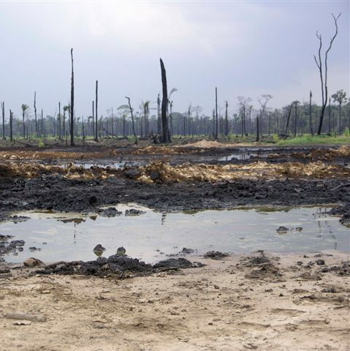
© Brain Wrinkles

Slide 32
Results
Venezuela leads South America in the production of carbon dioxide, which is a by-product of burning fossil fuels like natural gas & oil.
This can cause breathing problems for children & elderly.
It also contributes to global warming.
© Brain Wrinkles

Slide 33
Results
Oil businesses have damaged Lake Maracaibo (largest lake in South America).
Large amounts of oil have been removed from the area so the land is changing.
The eastern shore of the lake is dropping about three inches a year.
The government is having to take precautions to keep water from flooding into nearby towns.
© Brain Wrinkles

Slide 34
© Brain Wrinkles

Slide 35
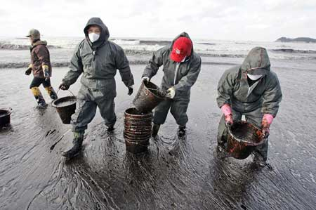
© Brain Wrinkles

Slide 36
Problem
Money from selling oil is the country’s main source of income.
Venezuelans are motivated to keep producing, selling, and burning oil--and polluting—because it boosts their economy.
© Brain Wrinkles

Slide 37
Solutions
People are becoming aware that the cost in the long term may be too great.
Groups are calling for renewable energy sources and the clean-up and prevention of pollution.
Venezuela’s state oil company is starting to clean up its oil pits and has a new policy that focuses on environmental protection.
© Brain Wrinkles

