Slide 1
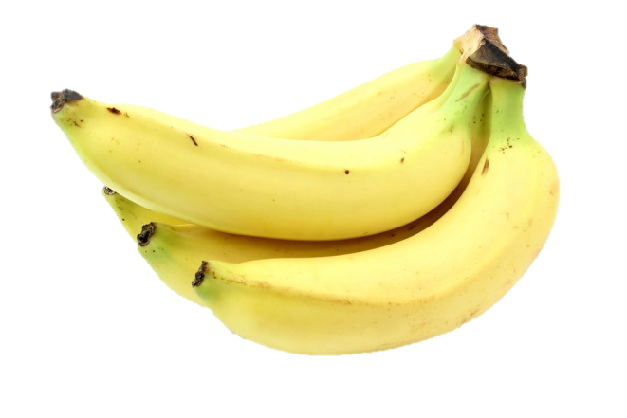
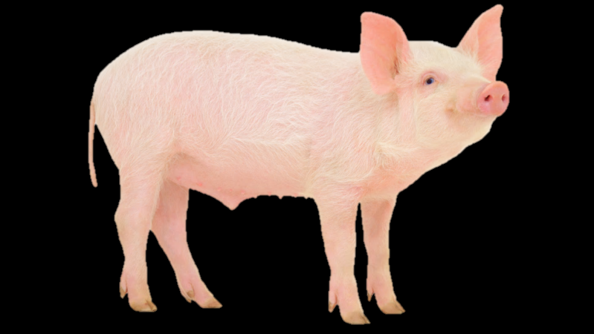
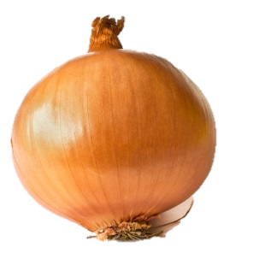
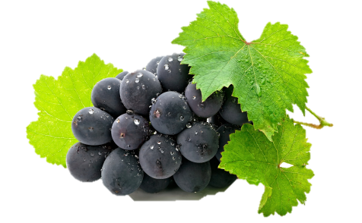
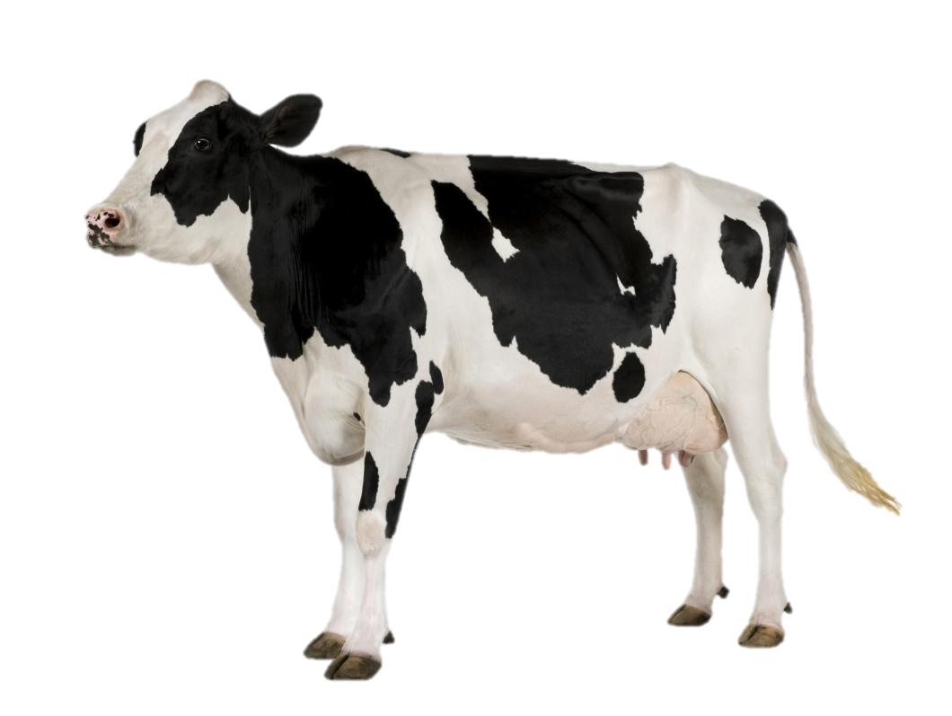
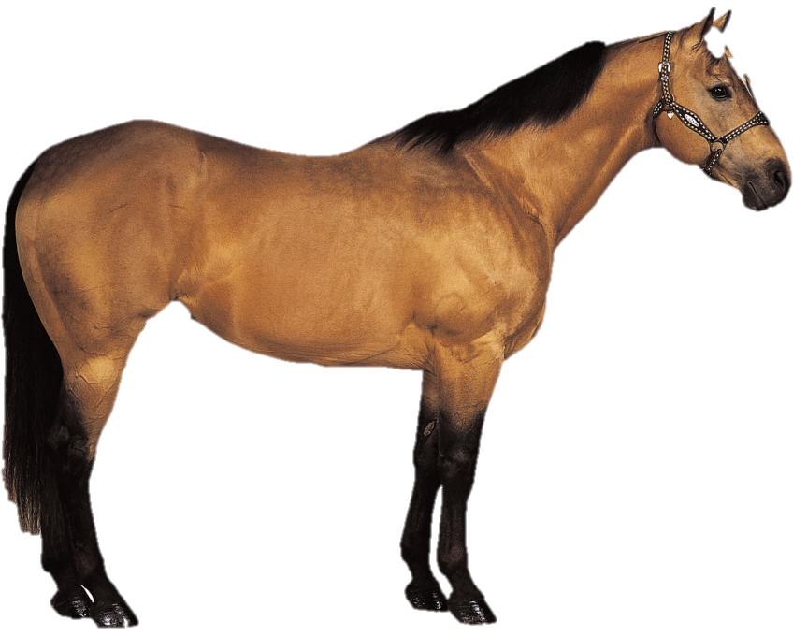
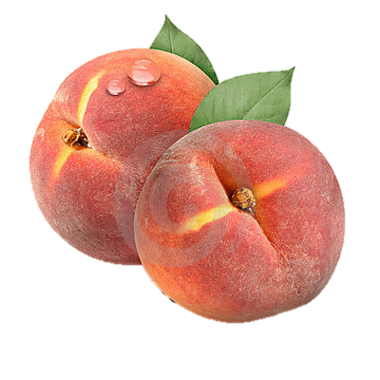
Where can you find the following:

Slide 2
Believe it or not, all of this came from Europe originally.

Slide 3
Essential Question: How did the Columbian Exchange impact Latin America?

Slide 4
Standards
SS6H1b. Explain the impact of the Columbian Exchange on Latin America and Europe in terms of the decline of the indigenous population, agricultural change, and the introduction of the horse.
SS6H2a. Describe the influence of African slavery on the development of the Americas.

Slide 5
The major consequence of the encounter of the Spanish with the Aztecs and Incas was the creation of a new Spanish empire.
Another consequence of the Spanish conquest of Latin America was a trading culture called the Columbian Exchange.

Slide 6
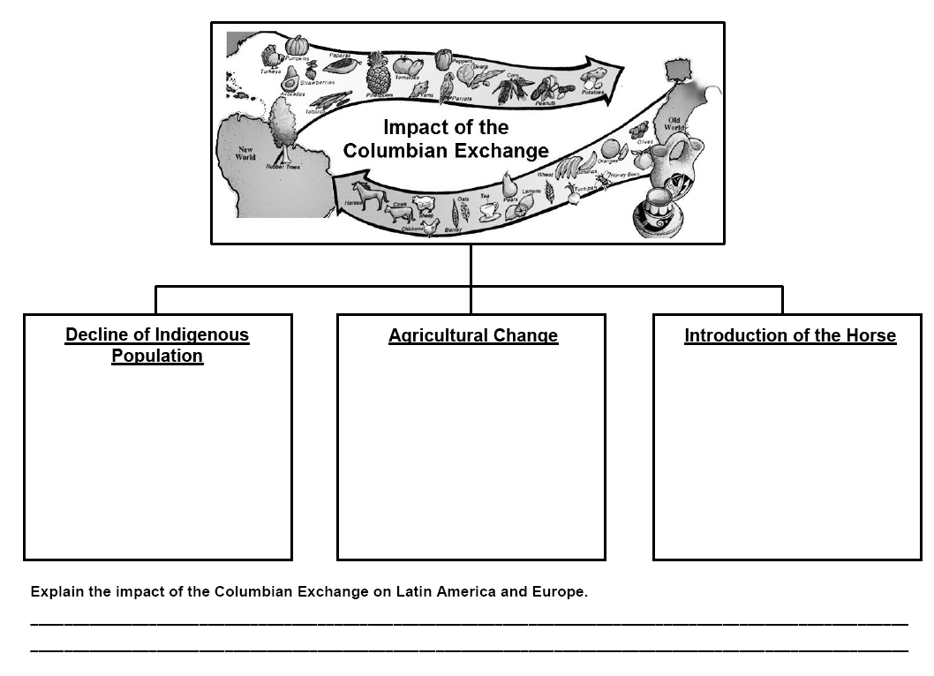
Use your Graphic Organizer

Slide 7
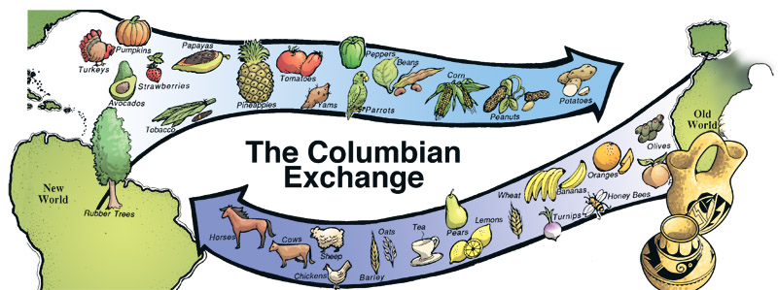
The Columbian Exchange describes the exchange of crops, goods, animals, and diseases between Europe and its colonies in the Americas.

Slide 8
Decline of Indigenous Population
European explorers brought diseases such as smallpox, measles, whooping cough, and influenza.
The indigenous populations did not have immunity to these diseases and died by the millions (estimated at 80% of the population).

Slide 9
Agricultural Change
New foods were bought to both Europe and Latin America in the Columbian Exchange.
Europe welcomed new vegetables like corn, tomatoes, peppers, pumpkins, squash, and cacao beans.
The Americas were introduced to wheat, barley, sugarcane, and livestock like cattle, pigs, and sheep.

Slide 10
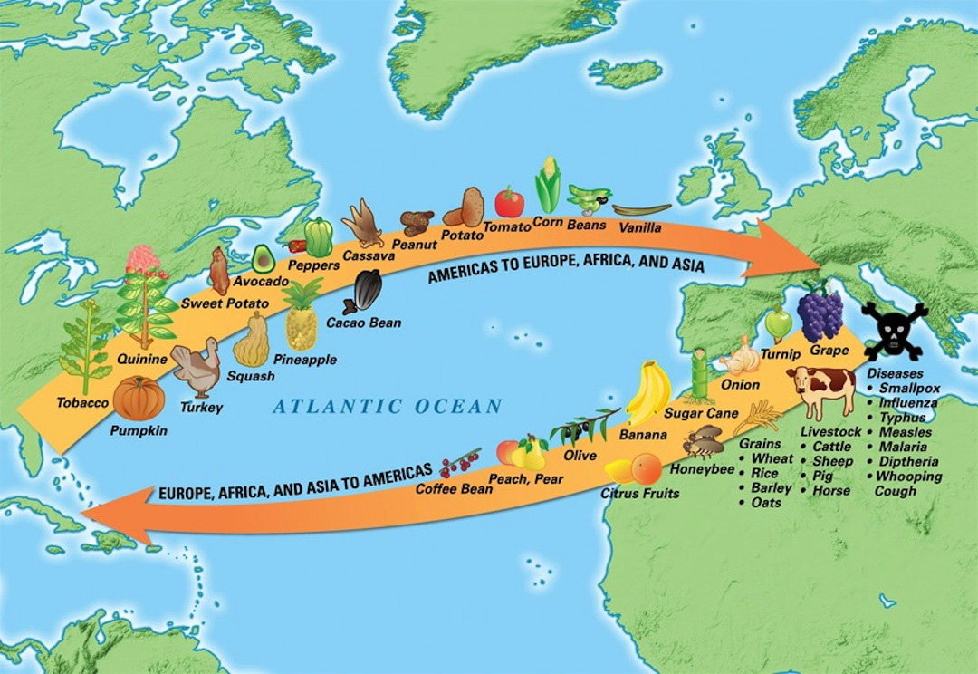
The Columbian Exchange caused an increase in food production which helped to increase human populations.
Many of these products like sugarcane later became the bases of some Latin American economies.

Slide 11
The horse, brought from Europe changed life forever in the Americas. Why?

Slide 12
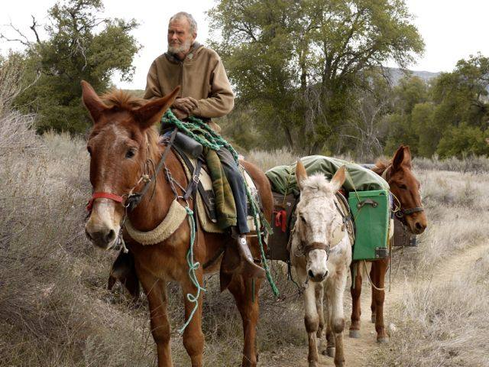
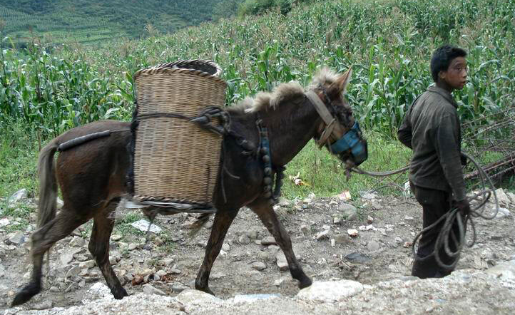
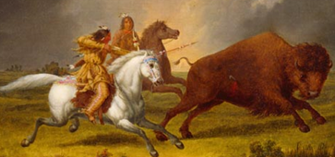
Uses of the Horse
Transportation
Labor
Hunting

Slide 13
Introduction of the Horse
Horses were used for transportation and labor
Horses changed the life of Native Americans on the plains, allowing them to hunt buffalo, an important source of food and other items
Horses remained the major method of transportation for people until the early 20th century

Slide 14
Columbian Exchange Map Activity [optional]

Slide 15
Many Spanish and Portuguese settlers moved to the Americas with plans to mine for gold and silver and grow sugarcane to export back to Europe.
Growing sugarcane in the tropical climate required a huge number of workers. Where did the Europeans plan on getting the workers?

Slide 16
The Spanish and Portuguese settlers planned on using the indigenous population (Native Americans) to man the sugarcane fields.
What was the problem?

Slide 17
Since diseases brought over by the Europeans killed many of the indigenous people in Latin America, the Europeans brought in black slaves from Africa.

Slide 18
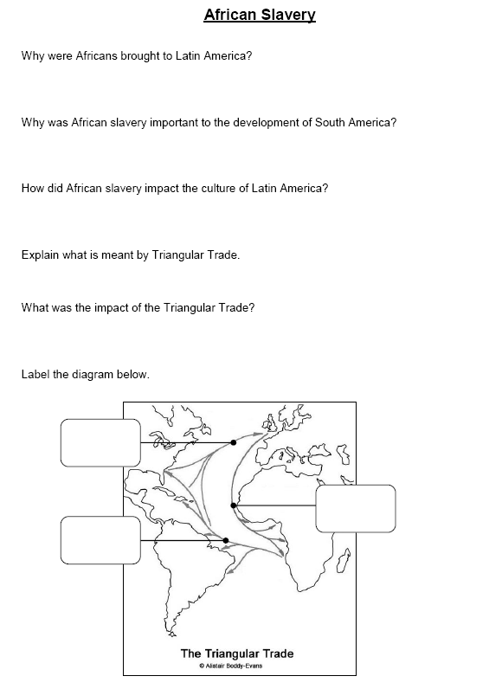
Continue with your Graphic Organizer Handout

Slide 19
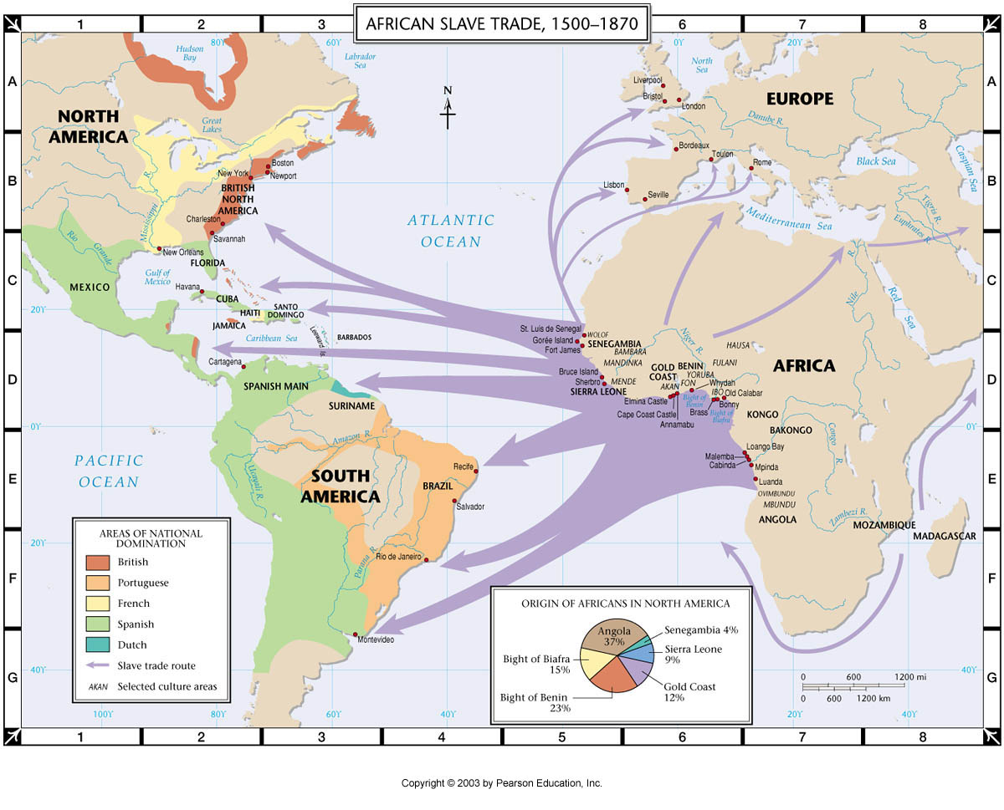

Slide 20
African Slavery
Africans were preferred as laborers because they had more immunity (resistance) to European diseases than Native Americans
African slavery was very important to the development of South America because it helped the sugarcane plantation economies grow

Slide 21
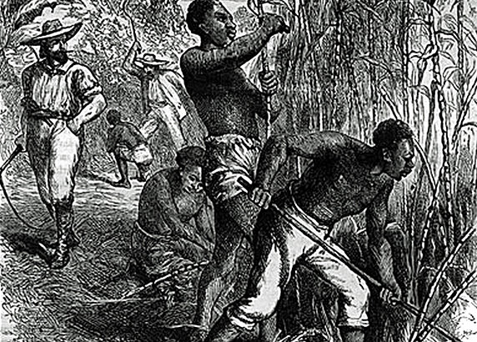
African Slavery
The growing and selling of sugarcane was the main source of income for Portuguese settlers in Brazil

Slide 22
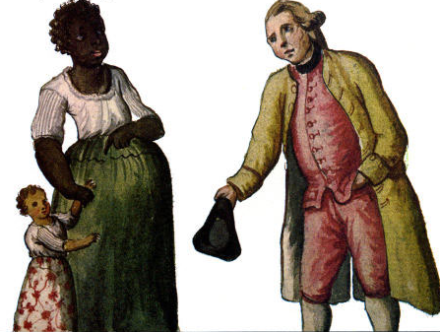
How did African slavery impact the culture of Latin America?
Mulatto
Some Europeans in Latin America married black slaves which created even more blended families and cultures.

Slide 23
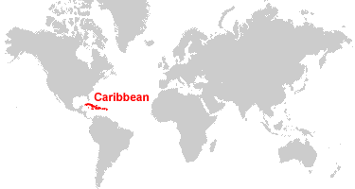
African Slavery
African slavery was also very important in the development of the Caribbean islands known as the West Indies.
European countries claimed the islands and began growing sugarcane as well as importing slaves from Africa.

Slide 24
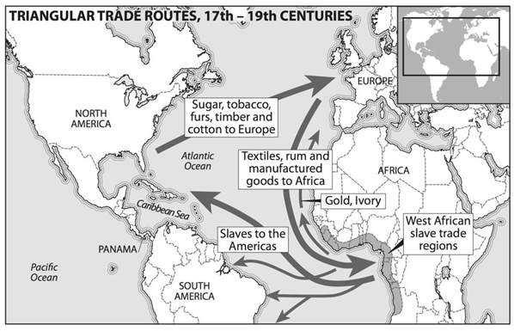
The system of trade between Africa, the Americas, and Europe became known as the Triangular Trade.

Slide 25
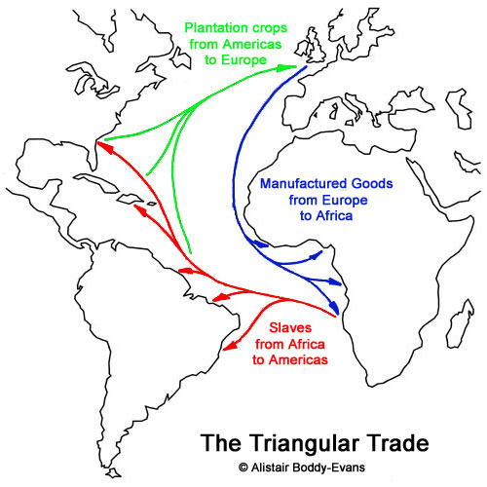

Slide 26
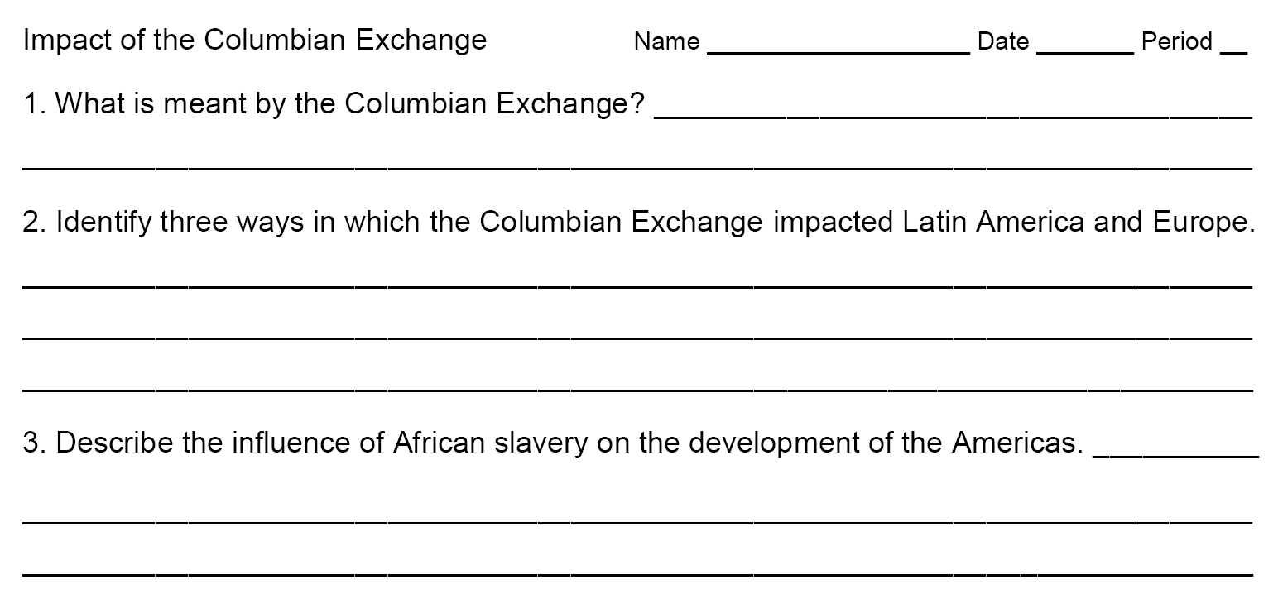
Summarizer

