Slide 1

Australia’s Government

Slide 2
Learning Target:
I can describe the structure of the national government of Australia.

Slide 3
Standard:
SS6CG7a. Describe the federal parliamentary democracy of Australia, distinguishing form of leadership, type of legislature, and the role of the citizen in terms of voting and personal freedoms.

Slide 4
Warm up:
Read and answer the questions below
How is power distributed in a federal
system of government?
Describe citizen participation in a democracy.
Describe how leadership is determined in
a parliamentary democracy.

Slide 5
Australia is a
Federal Parliamentary Democracy.

Slide 6
Use your graphic organizer to summarize the important information.

Slide 7
Australia has a federal system of government because it has individual states that share authority with a central government.
Federal
http://www.peo.gov.au/multimedia/videos/snapshots-federation/snapshots-federation-popup.html

Slide 8
Australia is a democracy. Democracy means the people have a say about how they are governed.
In Australia the people have their say by electing members of parliament to make decisions for the whole country. These members of parliament represent the people.

Slide 9
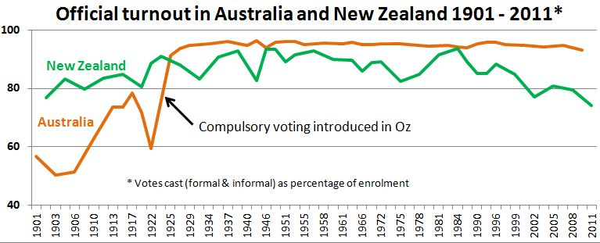
In Australia, voters are required to vote in elections. If they do not vote, they can be fined.

Slide 10
Parliament
Prime Minister
Voters choose representatives to the governing body, Parliament. It is bicameral (two houses) like Great Britain.
The party that wins the majority then selects the Prime Minister from one of its members to serve as the head of the government.
Parliamentary Democracy
Australia is governed under a parliamentary system. It is a democratic form of government in which voters choose representatives to a governing body called a parliament.
http://www.peo.gov.au/multimedia/videos/about-parliament-what-is-parliament/about-parliament-what-is-parliament-popup.html

Slide 11
Many of the functions and practices of the Australian Parliament are based on British Parliament. Why?

Slide 12
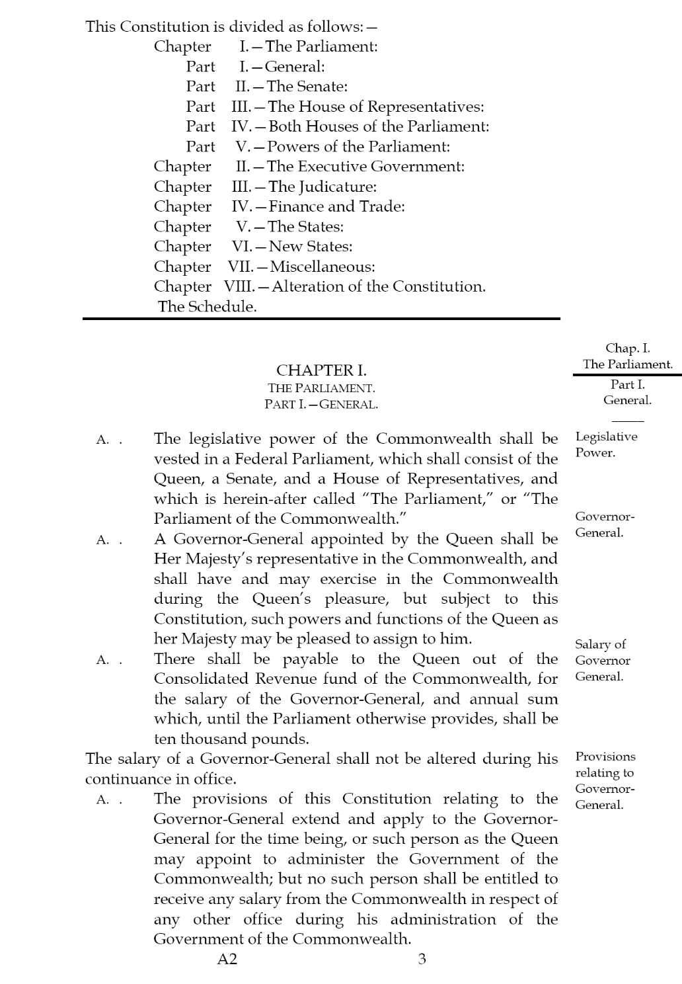
Examine the excerpt from Australia’s Constitution.
What is different about Australia’s Parliament? [Hint: Who makes up the Parliament according to the Constitution?]

Slide 13
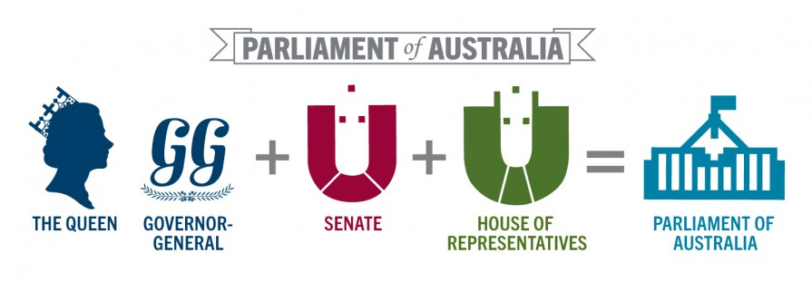

Slide 14
Australia is also known as a constitutional monarchy.

Slide 15
Australia has a monarch (Queen Elizabeth II) as the head of state.
The powers of the monarch are set out in the Constitution, along with the powers of the parliament and the courts.

Slide 16
Use the Graphic organizer to compare and contrast Australia’s government to the government of the
U.S. on the following:
Form of leadership (who has the power and how did they get it)
Type of legislature
Role of the citizen in terms of voting

Slide 17
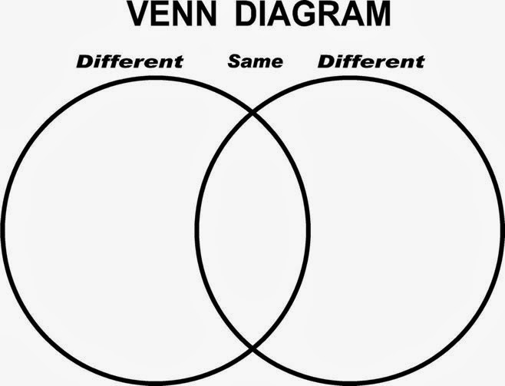
This Photo by Unknown Author is licensed under CC BY-SA-NC

